Slide 1
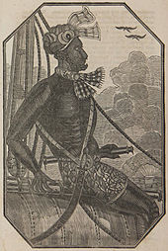
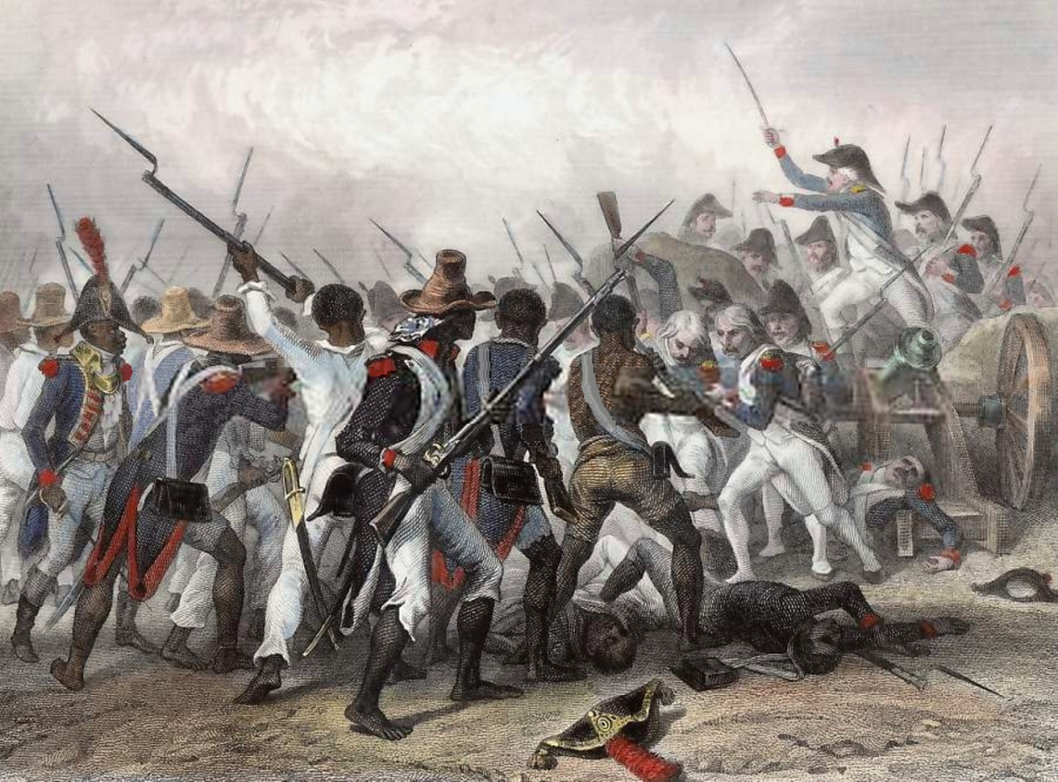
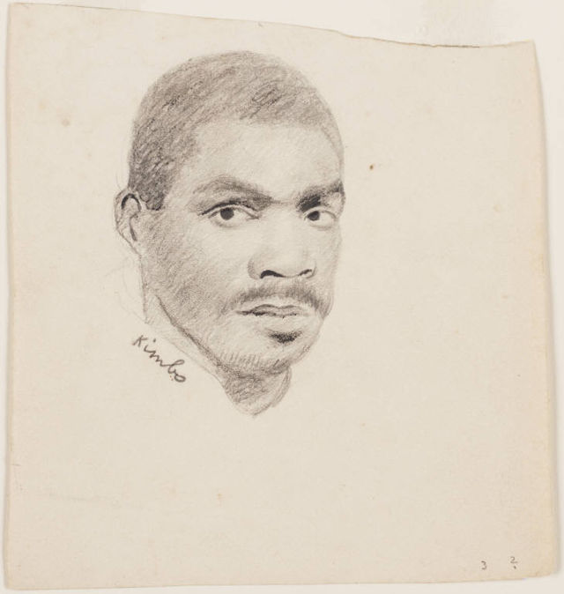
Land Empires of the New World

Slide 2
Class Goals You will be able to:
Understand the development of racialized slavery in the Atlantic World
Describe labor as a spectrum with Atlantic World racialized slavery at one extreme (Instead of a dichotomy of slavery versus freedom.)
Explain the ways Africans resisted and adapted to conditions in the New World

Slide 3
Movie Clip
https://www.youtube.com/watch?v=iMliaXlKxow
“When I looked round the ship too and saw. . .a multitude of black people of every description chained together, every one of their countenances expressing dejection and sorrow, I no longer doubted of my fate; and quite overpowered with horror and anguish, I fell motionless on the deck and fainted” (The Interesting Narrative of the Life of Olaudah Equiano, 2).

Slide 4
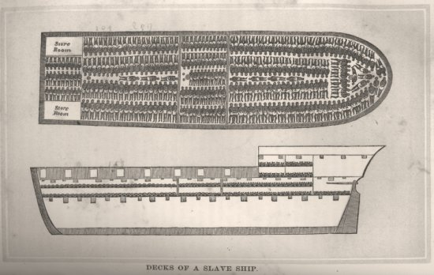
Transatlantic Slavery: The Middle Passage
Slavery was the engine of the Atlantic economy in the 17th and 18th centuries
Approximately 12 million people between 1500 and 1886
Middle Passage: The arduous journey between Africa and the New World
Slave traders in Senegal, 1700s

Slide 5
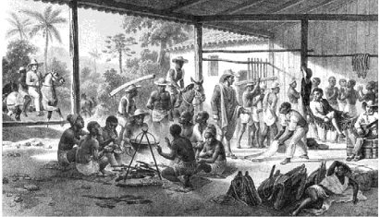
The Atlantic World
Markets of Americas, Europe, and Africa integrated into a global economic system
Ocean came to link the various societies of the Atlantic shores through maritime trade routes
Commercial products (cloth, firearms, liquor) for slaves or raw materials (sugar, coffee, cocoa, and cotton)
Recently purchased slaves in Brazil about to be transported to plantations (c. 1830)

Slide 6
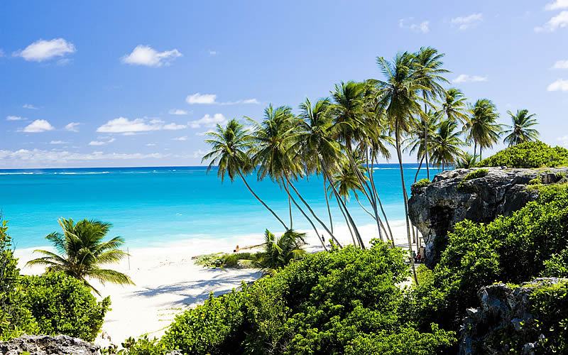
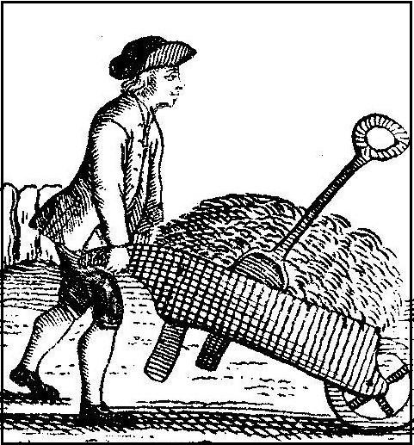
Case Study: Britain and Barbados
Barbados
England

Slide 7
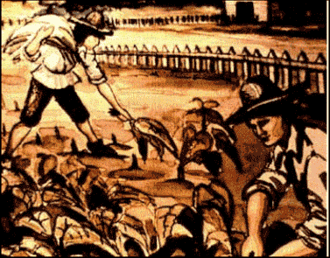
Labor in Britain
Population returned to pre-plague levels in the mid-1500s and continued to grow through the 1600s and 1700s
Excess labor
Problem: What to do with the poor.
Solution: Export indentured servants to New World colonies (Such as Barbados)

Slide 8
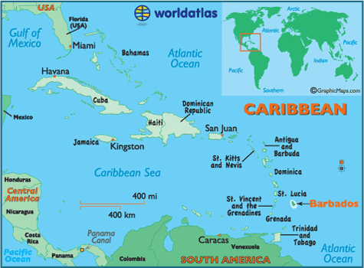
Barbados
Claimed by the Spanish and Portuguese in the 16th/17th centuries
First settled by the British in 1627/1628. The British controlled Barbados until 1966.
At first, the British
used white indentured
servants. Clearing the
land in order
to farm it was labor intensive.
Grew tobacco, cotton,
indigo

Slide 9
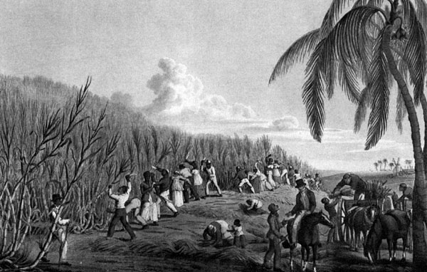
Barbados: Switch to sugar cane production
Land became consolidated in large plantations
African slaves brought in to work alongside white indentured servants
Far from the supervision of the colonial state, white elites treated both white and black laborers terribly
Many laborers died
White indentured servants who got their freedom stayed on the cane plantations
No opportunity for land ownership

Slide 10
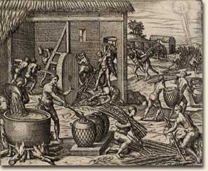
Transformation of Slavery in the Atlantic World
Development of racialized slavery (late 1600s)
Supply of white indentured servants decreased
Plantation labor came to be seen as an exclusively black role
Barbados: Something new. The combination of British labor practices, West African slavery, and the innovative cruelty of white elites on the island

Slide 11
Louis XIV’s “Code Noir”
Louis XIV’s Code Noir (1685)
Established the terms of slavery in the French colonies
Jews banned from French colonies
The child of two slaves was a slave; belonged to the owner of the mother
Gave owners permission to beat or execute slaves for misconduct
“A fugitive slave that shall continue out for a month. . .shall have both his ears cut off, and shall be branded on one of his shoulders with a fleur-de-lis. . .for the third offence, he shall be punished with death” (3)
Notes:
http://blogs.loc.gov/law/2011/01/slavery-in-the-french-colonies/
What intellectual movement was going on in France in 1685? Why might these thinkers object to the Code Noir?

Slide 12
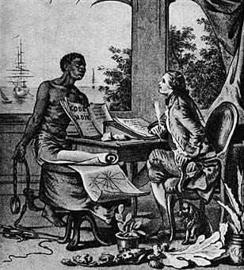
Louis XIV’s “Code Noir”
The Code was in effect until 1848
Criticism:
How does it connect with the ideas of the Enlightenment?
Voltaire: “The Black Code only serves to show that the legal scholars consulted by Louis XIV had no ideas regarding human rights.”
Notes:
http://blogs.loc.gov/law/2011/01/slavery-in-the-french-colonies/

Slide 13
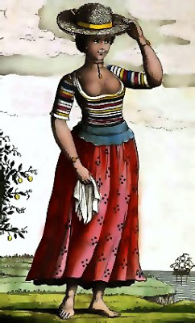
Resistance to Slavery in the Atlantic World
Maroons:
Communities in Jamaica, South America, and other Caribbean islands.
Jungle villages established by runaway slaves, hid out in remote areas to avoid returning to captivity
Preserved African languages and other cultural aspects
Slave Rebellions:
Toussaint L’Ouverture, Haiti, 1804
Nat Turner’s Rebellion, Virginia, 1831
Slaves created their own social world
Had their own marriage practices, preserved family life
Marriage:
In Surinam, black women were allowed to marry white men and attain wealth/status

Slide 14
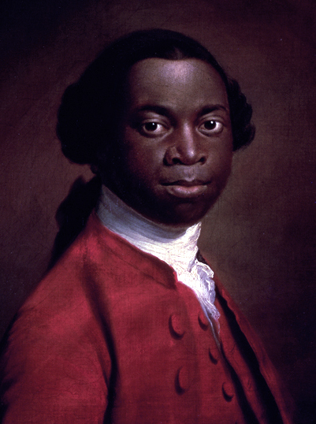
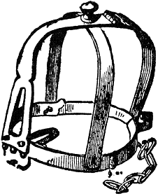
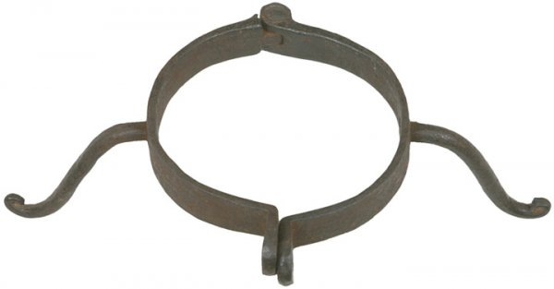
The Interesting Narrative of the Life of Olaudah Equiano
Olaudah Equiano (c. 1745-1797)
Nigeria (or South Carolina?)
Purchased freedom from a Quaker master
Abolitionist
Moral argument:
“Tortures, murder, and every other imaginable barbarity and iniquity are practiced upon the poor slaves with impunity. I hope the slave-trade will be abolished” (7).
Economic argument: “[Africa] lay open an endless field of commerce to the British manufacturers and merchant adventurers” (7).

Slide 15
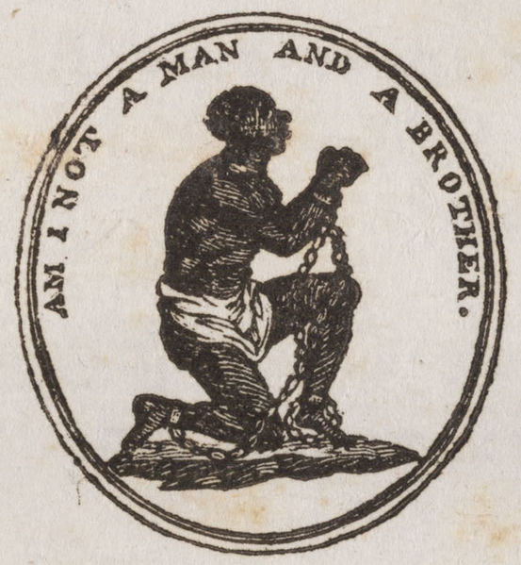
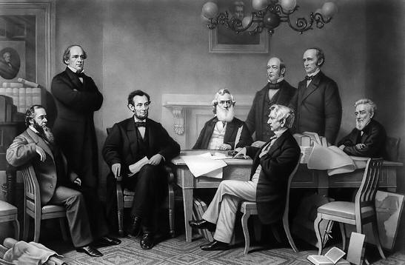
Abolition of Slavery
1808: Act prohibiting the importation of slaves to the United States took effect
1833: England
1848: France
1861: Russia
1863: United States
1888: Brazil
1962: Saudi Arabia, Yemen

Slide 16
Why did Atlantic slavery last so long?
Profit:
In 1700, a slave purchased in west Africa cost about 3 £ in goods (liquor, weapons, cloth), which could yield a profit of over 20 £ when he or she was sold in the Caribbean.
Documented cases of slaves being thrown overboard by ship captains in order to collect the insurance money
Demand
For luxury goods that were part of the triangle trade
For cheap labor on plantations
Pseudo-religious arguments:
Pro-slavery advocates claimed the Bible supported slavery
Pseudo-scientific arguments
Africans were biologically inferior

Slide 17
Racialized Slavery
Europeans used different forms of cheap labor:
Spanish encomienda system: Native Americans
British indentured servants
African slaves
Eventually slavery came to be seen as an exclusively African role once other sources of labor were less available
First slavery became exclusively African, then racism:
Scientific racism: the ideas that the human species is divided into races and some races are biologically inferior to the white race
Developed slowly.
French colonies: Code Noir, 1685
English colonies: late 1600s, slavery became a permanent state for people of African descent
But not fully articulated until the late nineteenth century
Notes:
(Distinguishing them from European indentured servants)

Slide 18
Race: An Illusion
“Scientific” racism is not scientific at all
Modern day science has proven that there is no genetic evidence to support the idea of racial difference
Race is an idea created by humans
Social construct
Like class and gender
Race means different things in different times
Race means different things in different parts of the world

Slide 19
A Spectrum of Labor Conditions
Rather than thinking of slavery vs. freedom, think of a spectrum of forced labor in which Atlantic World slavery is the most extreme form
Forced labor:
Performed involuntarily
Under the threat of punishment
Many “free” workers face dangerous conditions or do not earn a living wage
Raises the question: What rights should workers have?

Slide 20
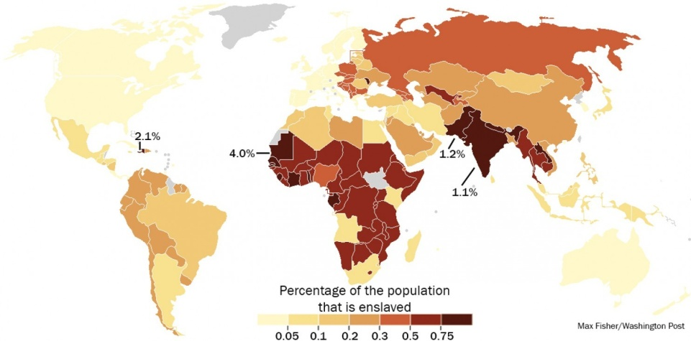
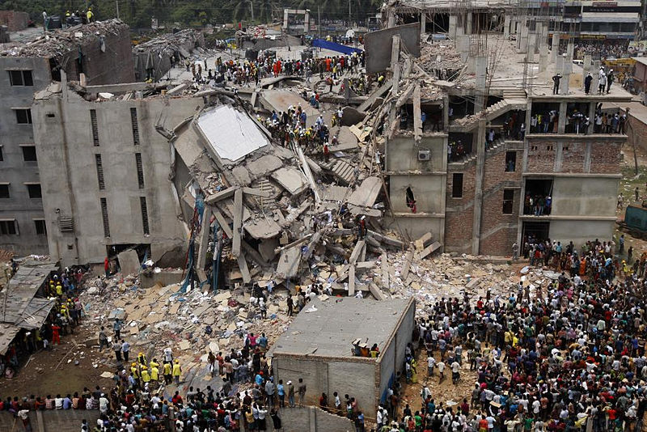
Spectrum of Labor in the Twenty-First Century
Slaves:
Sex slaves
30 million around the world; 60,000 in the U.S.
Undocumented workers in the U.S.
Chinese restaurant
Mexican agricultural workers
Unsafe conditions in garment
factories
2013 Factory collapse in Dhaka,
Bangladesh (1,129 dead)
Wage/Salary labor: The illusion of freedom?
Many Americans stay in their jobs because they need health insurance
Notes:
http://www.washingtonpost.com/blogs/worldviews/wp/2013/10/17/this-map-shows-where-the-worlds-30-million-slaves-live-there-are-60000-in-the-u-s/

Slide 21
Class Goals You will be able to:
Objectives:
Understand the development of racialized slavery in the Atlantic World
Describe labor as a spectrum with Atlantic World racialized slavery at one extreme (Instead of a dichotomy of slavery versus freedom)
Explain the ways Africans resisted and adapted to conditions in the New World
Terms:
Middle Passage
Indentured Servants
Maroons
Code Noir
Olaudah Equiano
Barbados

